Slide 1
Installing Git, GitHub desktop and sign up for GitHub account

Slide 2
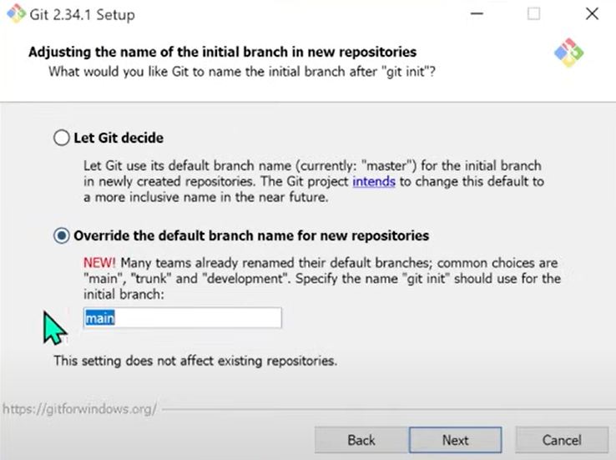
Git
https://git-scm.com/downloads/win
Use the default for installing except changing the initial branch as selected in the figure (main).

Slide 3

GitHub desktop
https://github.com/apps/desktop

Slide 4
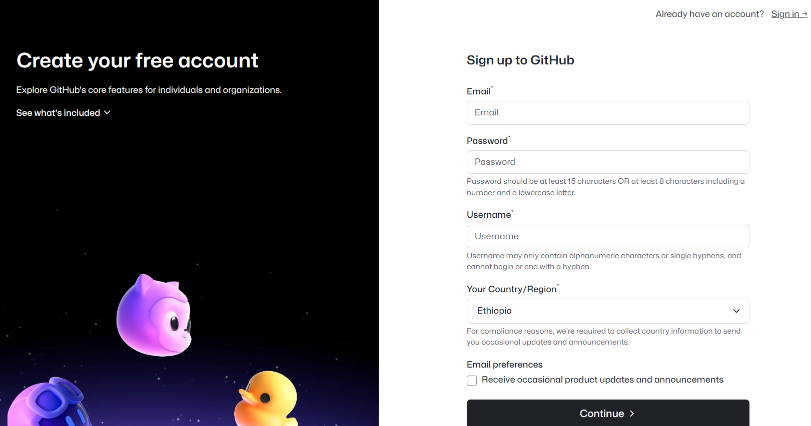
GitHub account
https://github.com/signup?source=login

